Slide 1
3GPP RAN Workshop on 3GPP submission towards IMT-2020 RWS-180019
October 24.-25. 2018, Brussels, Belgium
Self-Evaluation: URLLC and mMTC evaluation results
Source: Nokia

Slide 2
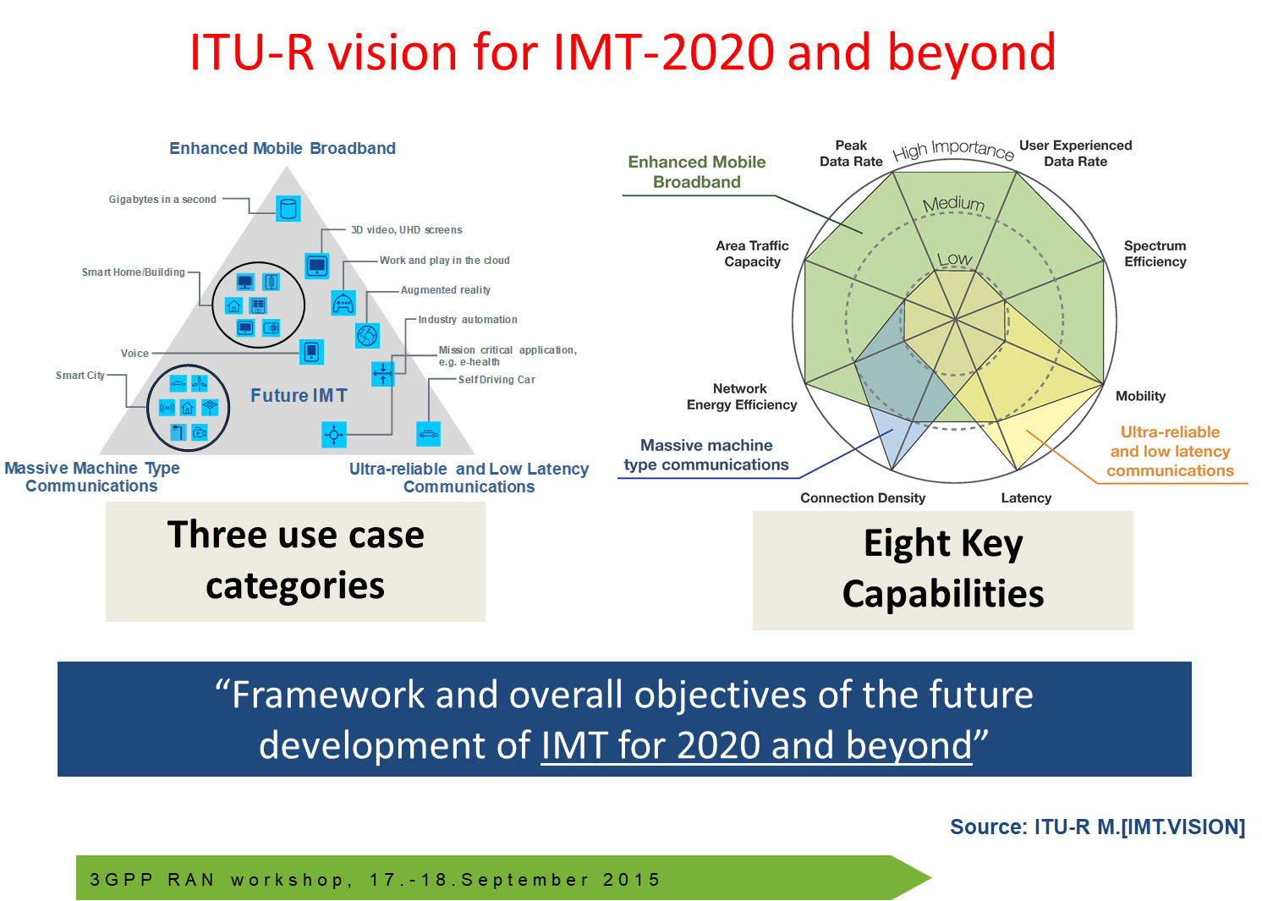
Categorization of IMT-2020 requirements
Source: 3GPP RWS-150036
Source: ITU-R Report M.2410-0
Peak data rate
Peak spectral efficiency
User experienced data rate
5th percentile user spectral efficiency
Average spectral efficiency
Area traffic capacity
Latency
User plane latency
Control plane latency
Connection density
Energy efficiency
Reliability
Mobility
Mobility interruption time
Bandwidth

Slide 3
Categorization of IMT-2020 requirements – URLLC and mMTC
Source: 3GPP RWS-150036
Source: ITU-R Report M.2410-0
Peak data rate
Peak spectral efficiency
User experienced data rate
5th percentile user spectral efficiency
Average spectral efficiency
Area traffic capacity
Latency
User plane latency
Control plane latency
Connection density
Energy efficiency
Reliability
Mobility
Mobility interruption time
Bandwidth

Slide 4
Requirements for URLLC and mMTC
Peak data rate
Peak spectral efficiency
User experienced data rate
5th percentile user spectral efficiency
Average spectral efficiency
Area traffic capacity
Latency
User plane latency
Control plane latency
Connection density
Energy efficiency
Reliability
Mobility
Mobility interruption time
Bandwidth
Requirement | Required value
Latency, user plane | 1 ms for URLLC
Latency, control plane | 20 ms
Connection density | 1 000 000 devices / km²
Reliability | 99.999% success rate within 1 ms
Mobility interruption time | 0 ms
URLLC requirement
mMTC requirement

Slide 5
Latency, control plane (URLLC)
“Control plane latency refers to the transition time from a most “battery efficient” state (e.g. Idle state) to the start of continuous data transfer (e.g. Active state). […] The minimum requirement for control plane latency is 20 ms. [M.2410-0]
Number of configurations evaluated
 | Evaluated | Passed
NR FDD | 94 | 94
NR TDD | 256 | 256
LTE FDD | 1 | 1
LTE TDD | 12 | 12
Example: 35 NR FDD configurations for 6-symbol PRACH (ms)
Control plane latency NR FDD |  | UE capability 1 |  |  |  | UE capability 2
 |  | Subcarrier spacing |  |  |  | Subcarrier spacing
Allocation |  | 15 kHz | 30 kHz | 60 kHz | 120 kHz | 15 kHz | 30 kHz | 60 kHz
Mapping Type A | 4 symbols | 15.6 | 13.5 | 12.4 | 11.7 | 15.1 | 13.0 | 12.1
 | 7 symbols | 15.8 | 13.6 | 12.5 | 11.7 | 15.3 | 13.1 | 12.2
Mapping Type B | 2 symbols | 13.7 | 12.3 | 11.9 | 11.4 | 13.4 | 12.0 | 11.7
 | 4 symbols | 14.2 | 12.5 | 12.0 | 11.5 | 13.9 | 12.3 | 11.8
 | 7 symbols | 15.3 | 13.0 | 12.3 | 11.6 | 14.8 | 12.8 | 12.1
Requirement of 20 ms control plane latency is met with all evaluated configurations

Slide 6
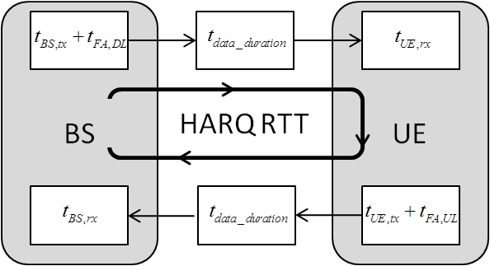
Latency, user plane (URLLC)
“User plane latency is the contribution of the radio network to the time from when the source sends a packet to when the destination receives it (in ms). […] The minimum requirements for user plane latency are […] 1 ms for URLLC. [M.2410-0]
Number of configurations evaluated
Example: 84 NR FDD DL configurations (ms)
 | Downlink |  | Uplink
 | Evaluated | Passed | Evaluated | Passed
NR FDD | 84 | 64 | 98 | 67
NR TDD | 368 | 225 | 370 | 148
LTE FDD | 8 | 5 | 8 | 5
LTE TDD | 8 | 0 | 6 | 0
DL user plane latency NR FDD |  |  | UE capability 1 |  |  |  | UE capability 2
 |  |  | Subcarrier spacing |  |  |  | Subcarrier spacing
Allocation |  | Re-Tx | 15 kHz | 30 kHz | 60 kHz | 120 kHz | 15 kHz | 30 kHz | 60 kHz
Mapping Type A | 4 symbols | p=0 | 1.37 | 0.76 | 0.54 | 0.34 | 1.00 | 0.55 | 0.36
 |  | p=0.1 | 1.58 | 0.87 | 0.64 | 0.40 | 1.12 | 0.65 | 0.41
 | 7 symbols | p=0 | 1.49 | 0.82 | 0.57 | 0.36 | 1.12 | 0.61 | 0.39
 |  | p=0.1 | 1.70 | 0.93 | 0.67 | 0.42 | 1.25 | 0.71 | 0.44
 | 14 symbols | p=0 | 2.13 | 1.14 | 0.72 | 0.44 | 1.80 | 0.94 | 0.56
 |  | p=0.1 | 2.43 | 1.29 | 0.82 | 0.51 | 2.00 | 1.04 | 0.63
Mapping Type B | 2 symbols | p=0 | 0.98 | 0.56 | 0.44 | 0.29 | 0.49 | 0.29 | 0.23
 |  | p=0.1 | 1.16 | 0.67 | 0.52 | 0.35 | 0.60 | 0.35 | 0.28
 | 4 symbols | p=0 | 1.11 | 0.63 | 0.47 | 0.31 | 0.66 | 0.37 | 0.27
 |  | p=0.1 | 1.30 | 0.74 | 0.56 | 0.36 | 0.78 | 0.45 | 0.32
 | 7 symbols | p=0 | 1.30 | 0.72 | 0.52 | 0.33 | 0.93 | 0.51 | 0.34
 |  | p=0.1 | 1.49 | 0.83 | 0.61 | 0.39 | 1.08 | 0.59 | 0.40
Requirement of 1 ms user plane latency is met with a number of different configurations

Slide 7
Reliability (URLLC)
“Reliability relates to the capability of transmitting a given amount of traffic within a predetermined time duration with high success probability. […] The minimum requirement for the reliability is 1-10⁻⁵ success probability […] within 1 ms in channel quality of coverage edge… [M.2410-0]
“It is sufficient to fulfil the requirement in either downlink or uplink, using either NLOS or LOS channel conditions.” [M.2412-0]
Number of configurations evaluated
Example: 9 NR FDD DL configurations at 4 GHz (ms)
 | Downlink |  | Uplink
 | Evaluated | Passed | Evaluated | Passed
NR FDD | 16 | 16 | 26 | 26
NR TDD | - | - | 1 | 1
LTE FDD | - | - | - | -
LTETDD | - | - | - | -
Antenna configuration | Allocation | Sub-carrier spacing | Channel | Channel model A | Channel model B
2x2 SU-MIMO | 14 symbols, slot aggregation | 60 kHz | NLOS | 99.999899% | 99.99991%
2x2 SU-MIMO | 4 symbols, HARQ re-tx | 30 kHz | NLOS | 99.999898% | 99.99995%
2x2 SU-MIMO | 4 symbols, one shot | 30 kHz | NLOS | 99.99971% | 99.99969%
2x4 SU-MIMO | 7 symbols, one shot | 30 kHz | NLOS | >99.9999% | >99.9999%
32x8 SU-MIMO | 14 symbols, one shot | 30 kHz | NLOS | 99.9999% | -
Requirement of 99.999% reliability within 1 ms packet delivery is met in all evaluated configurations

Slide 8
Mobility interruption time (URLLC)
“Mobility interruption time is the shortest time duration supported by the system during which a user terminal cannot exchange user plane packets with any base station during transitions.[…]The minimum requirement for mobility interruption time is 0 ms.” [M.2410-0]
“The procedure of exchanging user plane packets with base stations during transitions shall be described based on the proposed technology including the functions and the timing involved.” [M.2412-0]
DC mobility procedure (Scell addition)
Technical feature | Meets requirement
NR beam mobility | Yes
NR CA mobility | Yes
LTE Pcell mobility | Yes
LTE DC mobility | Yes
Requirement of zero ms mobility interruption time is met

Slide 9
Connection density (mMTC)
“Connection density is the total number of devices fulfilling a specific quality of service (QoS) per unit area (per km²). […] The minimum requirement for connection density is 1 000 000 devices per km². ” [M.2410-0]
“The requirement is fulfilled if the 99th percentile of the delay per user D_{i} is less than or equal to 10s, and the connection density is greater than or equal to the connection density requirement... ” [M.2412-0]
Connection density evaluation results (full buffer method)
Technical feature | ISD (m) | Scheme and antenna config. | Sub-carrier spacing | Channel model A |  | Channel model B
 |  |  |  | Connection density (device/km²) | Required bandwidth (kHz) | Connection density (device/km²) | Required bandwidth (kHz)
NR | 500 | 1x2 SIMO OFDMA | 15 kHz | 35,569,150 | 180 | 35,082,937 | 180
 | 1732 |  |  | 1,267,406 |  | 1,529,707
NB-IoT | 500 | 1x2 SIMO | 15 kHz | 43,691,789 | 180 | 43,626,653 | 180
 | 1732 |  |  | 2,335,319 |  | 2,376,936
eMTC | 500 | 1x2 SIMO | 15 kHz | 35,235,516 | 180 | 34,884,438 | 180
 | 1732 |  |  | 1,212,909 |  | 1,511,989
Requirement of 1 000 000 devices/km² is met in all evaluated cases

Slide 10
Summary
Large number of different configurations evaluated against the URLLC and mMTC requirements
Requirement | Required value | NR | LTE
Latency, user plane | 1 ms for URLLC | Meets requirement | Meets requirement
Latency, control plane | 20 ms | Meets requirement | Meets requirement
Connection density | 1 000 000 devices / km² | Meets requirement | Meets requirement
Reliability | 99.999% success rate within 1 ms | Meets requirement | Not evaluated
Mobility interruption time | 0 ms | Meets requirement | Meets requirement
3GPP successfully completed the preliminary self evaluation on URLLC and mMTC

Slide 11



